Slide 1


Electricity Powertrust Dashboard
St. Clair College
GROUP - 5
Apurv Hiteshkumar Sathwara - 0792620
Bhakti Dineshbhai Bhatt - 0788808
Dhrumi Tapas Patel - 0793770
Smit Arora - 0795650
Vismay Lad - 0794141
GitHub link: https://bit.ly/3y3rzPq

Slide 2
Table of Contents
About the company
Problem Statement
Research Questions / Objectives
Analytical Goals
Dataset
Preprocessing data
Exploratory Data Analysis
Dashboards
Summary
References

Slide 3

About the Company
Powertrust is the world’s leading supplier of high impact renewable electricity in emerging markets. Powertrust uses its proprietary digital infrastructure and the global REC standard to provide end-to-end procurement, certification, and analytics to its customers. Powertrust bridges the gap between small scale distributed energy in emerging markets and corporate global sustainability goals.
www.powertrust.com

Slide 4

Problem Statement
Over 759 million people continue to lack access to basic electricity and another 2 billion people suffer from inadequate and unreliable access.
Problem Identification –
Effective visualization and communication of data is crucial for decision making and measuring the success of renewable energy projects.
The challenge lies in effectively presenting and interpreting the data in a way that accurately reflects the performance and impact of the renewable energy projects.
Dataset include technical data from electricity meter readings and commercial information from contracts, as well as industry standards for impact metrics. Which is difficult to understand by non-technical team or other members.

Slide 5

Research Questions/Objectives
What are the key performance indicators that should be included in the dashboard?
Adequate use of all the given data
Lucrative Visualizations
How can the dashboard help Powertrust to identify areas for improvement in their renewable energy projects?
Exploratory Data Analysis
In-depth findings
Data-driven Statistics
How can the dashboard be used to communicate the impact of REP to stakeholders, including investors, customers?
Visualized data
Providing Context
Easy to understand

Slide 6
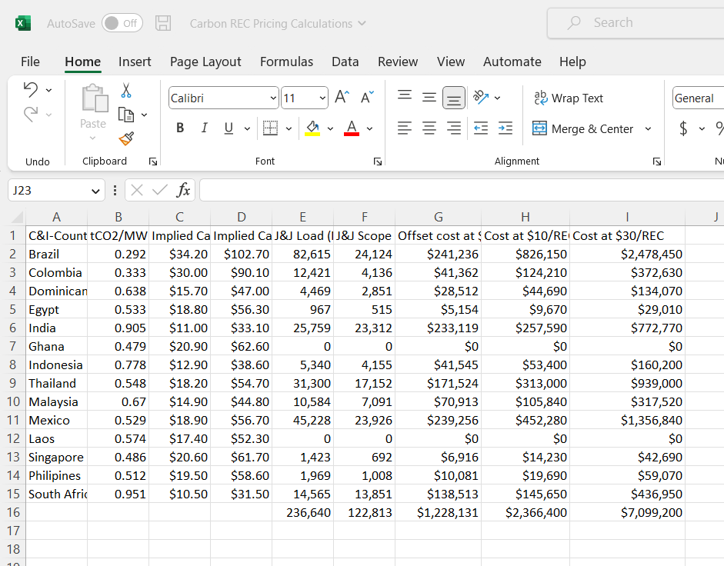
Data
The data has been provided by the Powertrust’s stakeholder which contains total of 12 excel csv files.
It includes information about how much electricity produced by REC and how much offset cost at a $10 and $30/REC across the globe.
The other files have data about renewable energy production in a year 2022 with Timestamp.
The datasets feature a mix of numeric and categorical variables (with numerical variables being in overwhelming majority).
It also include few of REC terms such as MWh, KWh, Capex, tCO2/MWh, J&J Load etc.

Slide 7
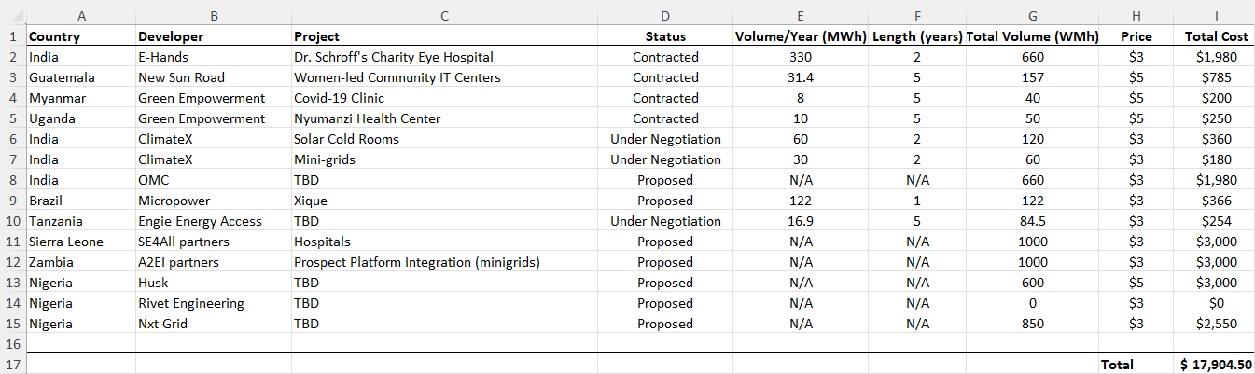
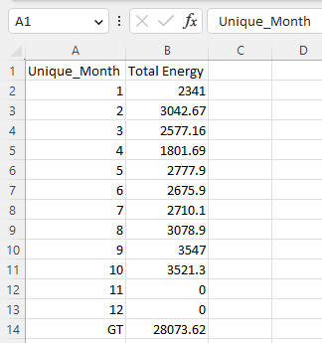
The Datasets provided by the stakeholder about the cities of India have contained Timestamp and MWh Production of City.
We have merged all the different datasets by city wise and identified the unique months and total generation of each city.
Also, the dataset about Projects and its Developer given was used in Tablue visualization to make it more effective and attractive.

Slide 8
Data Pre-Processing
There were few blank cells available in the provided data which we have removed with the help of Excel and made the data convenient for visualizations.
Also, we have done merging of data files of cities for the other dashboard because they all have similar kind of data but different cities.

Slide 9

Exploratory Data Analysis

Slide 10
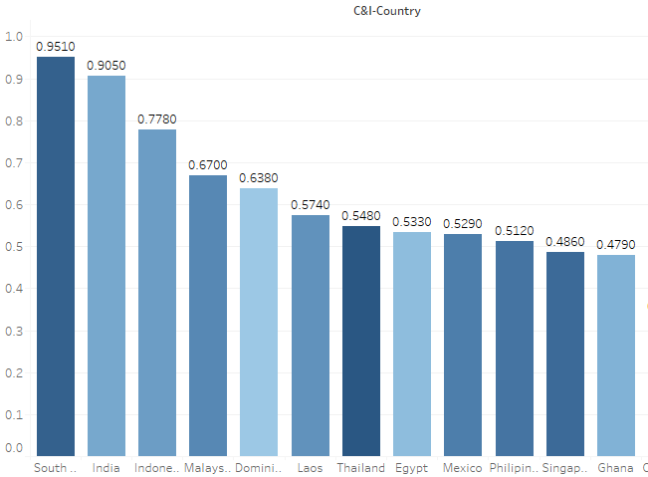
Carbon Intensity of Electricity Generation by country
The countries represented in the visualization are arranged in descending order of electricity generation.
South Africa has the highest carbon intensity of all the countries represented, with a value of 0.95 tCo2/MWh(t/m). India comes in second with a carbon intensity of 0.91 t/m.
Among these countries, Colombia and Brazil have the lowest carbon intensities of 0.33 and 0.29 t/m, respectively.

Slide 11
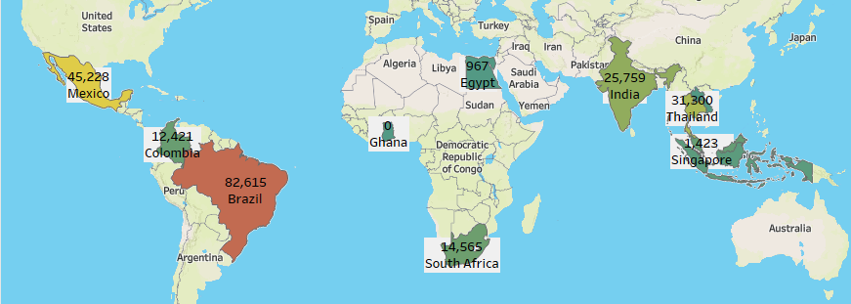
Production of Renewable Energy at J&J Across The Globe
The presented symbol map graph portrays the production of renewable energy at Johnson & Johnson facilities worldwide. The data indicates that Brazil has the highest production of renewable energy, with an annual production of 82,615 MWh.
Following closely behind is Mexico, with a production of 45,228 MWh per year. In India, the production of renewable energy at Johnson & Johnson facilities is approximately 25,759 MWh per year. Conversely, Egypt has the least production of renewable energy, with an annual production of 967 MWh.
Notably, Ghana and Laos do not appear to have contributed to the production of renewable energy at Johnson & Johnson facilities, as no data is presented for these countries in the symbol map graph.

Slide 12
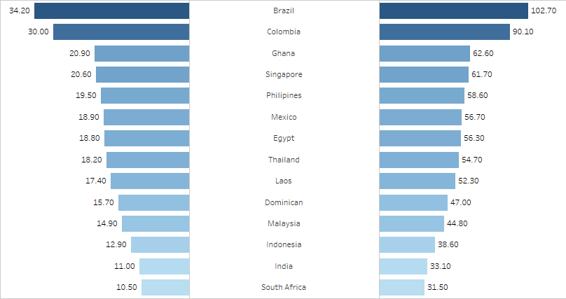
Implied Carbon Prices As per The Country
This graph shows the Implied Carbon Price at $10 and $30 per individual Country.
Where it stated that Brazil has the highest carbon price imposed as per its production of the REC.

Slide 13
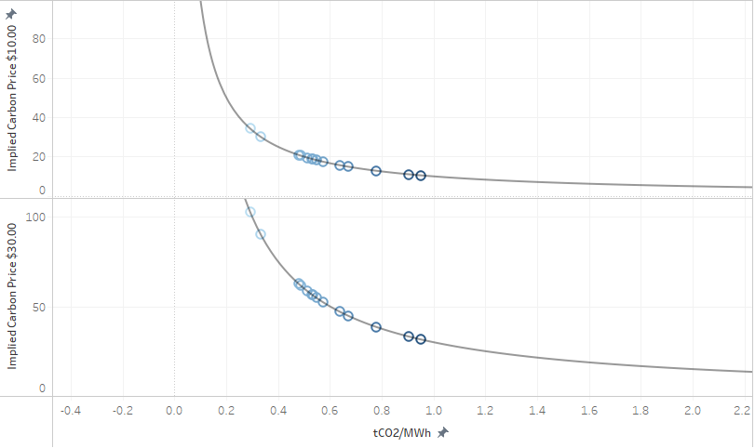
Implied carbon price at Total Carbon dioxide
The scatter plot displays the carbon price for each country at two different price points, $10 and $30.
As you can see the price of tco2 is decreasing as per the Implied Carbon price.

Slide 14
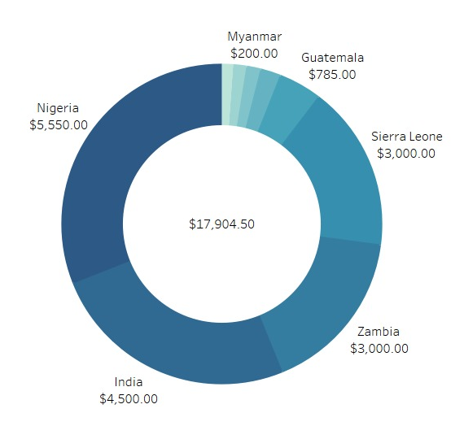
Total cost of Project
The donut chart serves as a useful tool in visualizing the allocation of project cost across different countries. It highlights the disparities in project costs and emphasizes the need for equitable distribution of resources to ensure the successful completion of all projects.
Additionally, it underscores the importance of effective cost management strategies to maximize project outcomes while minimizing costs.

Slide 15
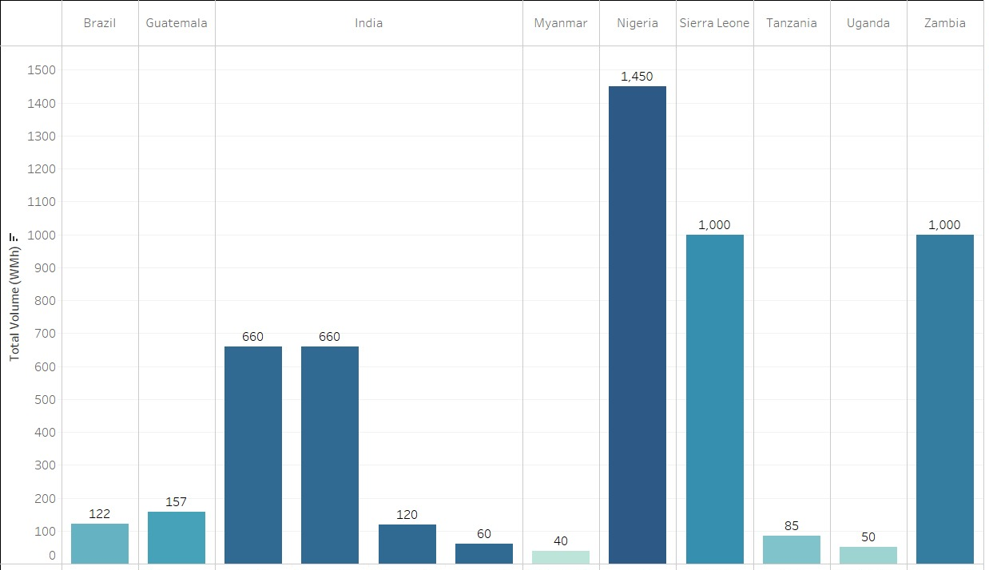
Total Volume by Country and Project
The bar chart effectively conveys the varying production volumes across different countries and renewable energy projects.
It provides valuable insights into the performance of individual projects and underscores the importance of continuous monitoring and evaluation to optimize production output by Country.

Slide 16
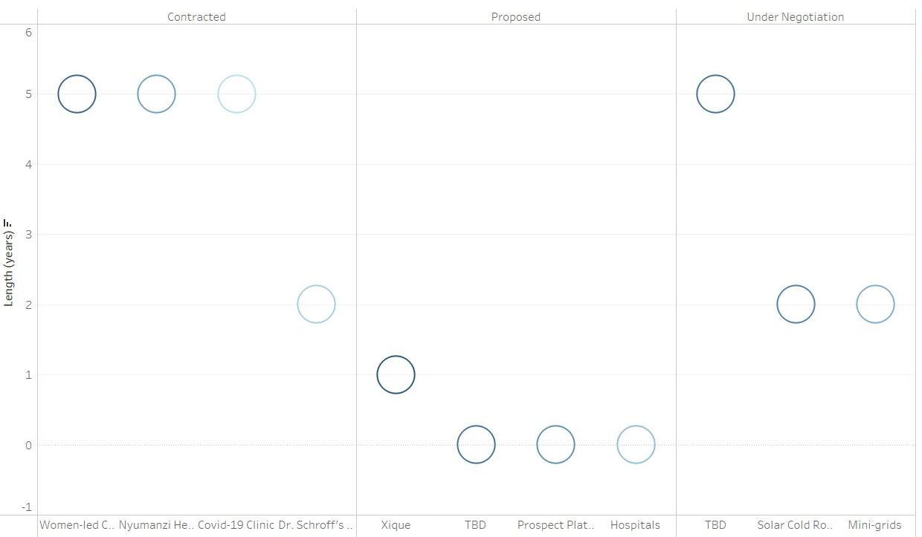
Project Status by Length of Years
This side-by-side circle visualization in Tableau shows the status of projects over the years, with three different categories of projects: contracted, proposed, and under negotiation.
The COVID-19 Clinic, Nyumanzi Health Center, and Women-led Community IT Centers have been running under the contracted status for 5 years, while Dr. Schroff's Charity Eye Hospital has been under the contracted status for 2 years.
The Xique project has been running under the proposed category for 1 year.

Slide 17
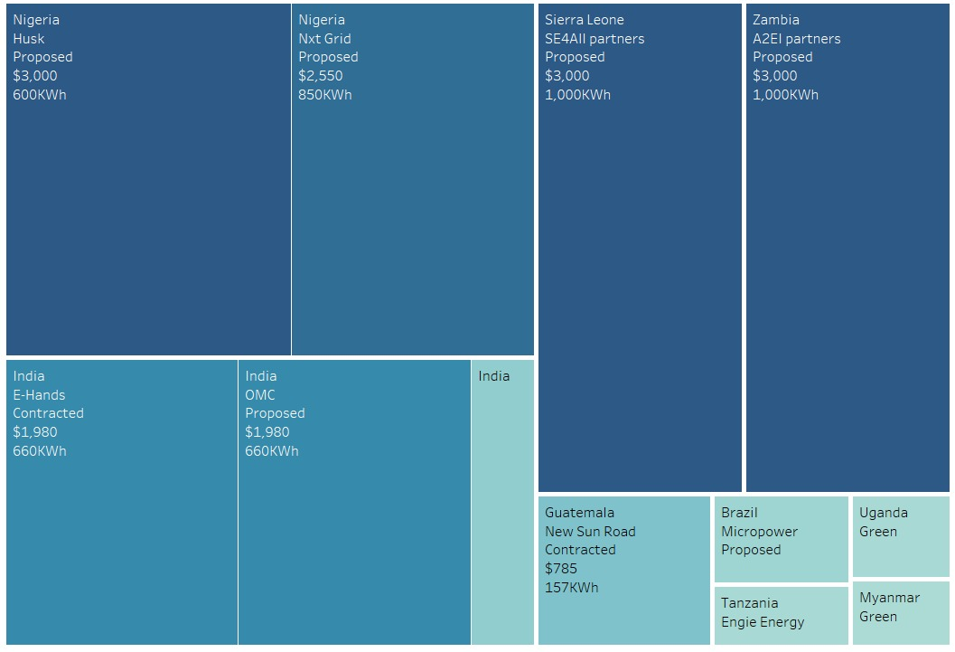
Insights about projects and its outcomes
The tree map visually depicts the aggregate cost and volume of renewable energy across individual projects within a specified county.
Based on the available information, it appears that the project known as TBD is presently underway in Nigeria, generating 1450WMh of renewable energy and entailing a total cost of 5550$.

Slide 18
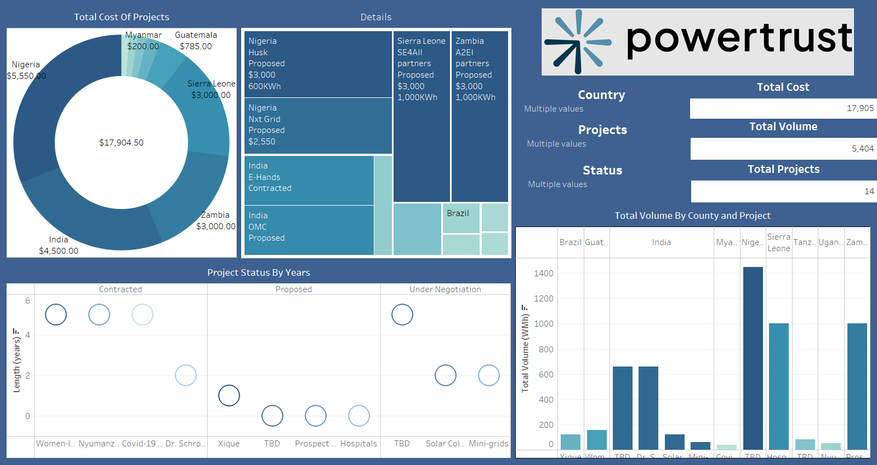

Slide 19
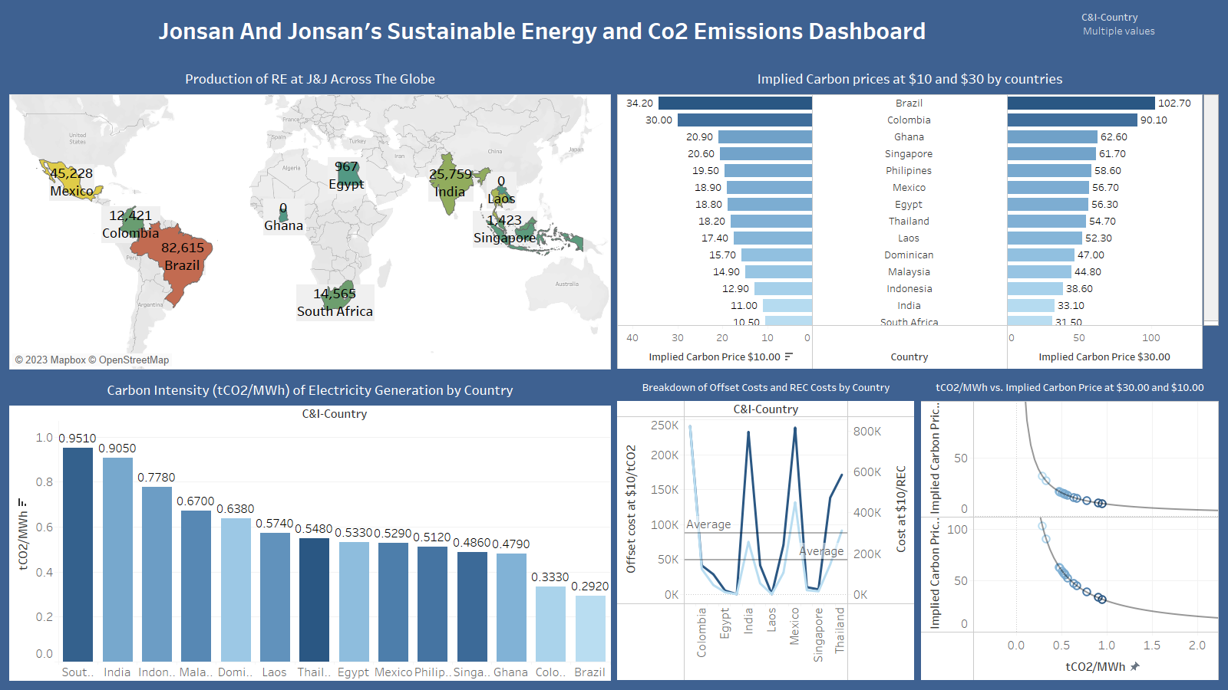

Slide 20
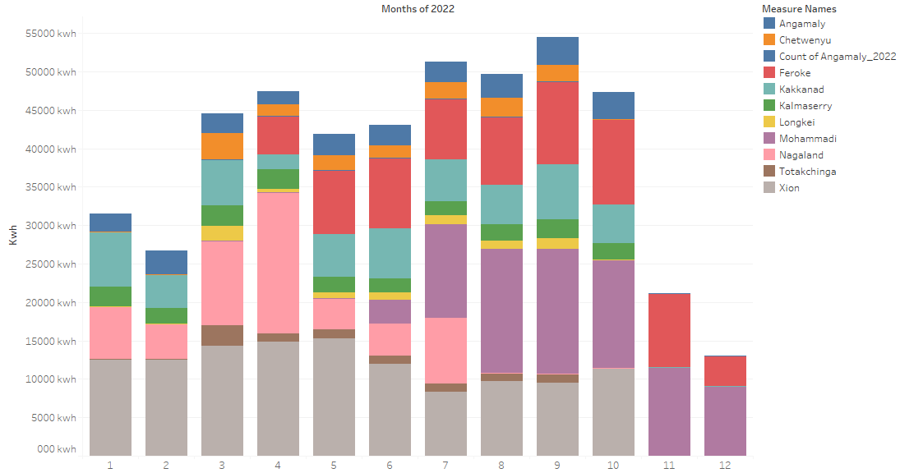

Slide 21
Summary
The purpose of the dashboard is to support decision-making, promote transparency, and improve the understanding of the electricity sector.
Data visualization: The dashboard will provide visual representations of data, such as charts, graphs, and maps, to help users understand and interpret data more easily.
Data analysis: To support the discovery of insights and trends in the data.
Customization: Allow users to customize their view of the data, such as by selecting specific country or metrics to display, to analyse their specific needs and requirements.
User experience: The dashboard may have a user-friendly and intuitive interface to make it easy for users to access and use the data and insights provided.

Slide 22

References
. https://www.powertrust.com
https://towardsdatascience.com/exploratory-data-analysis-8fc1cb20fd15
https://www.eea.europa.eu/themes/energy/renewable-energy/renewable-energy-in-europe-2022
https://www.cer-rec.gc.ca/en/data-analysis/energy-commodities/electricity/report/canadas-renewable-power/index.html

Slide 23

Thank You

